Slide 1
Policy Evaluation

Slide 2
Objectives
Immediate and long term goals
Reward, Return and Value functions
Random Walk Environment
Monte Carlo prediction (MC)
Temporal-Difference Learning (TD)
Batch updating
n-steps TD
TD(𝜆)
Backward-view TD(𝜆)
Comparison

Slide 3
Immediate and long term goals
Balancing immediate and long-term goals is challenging
should I watch Netflix tonight?
immediate satisfaction
keep studying reinforcement learning?
maybe (and only maybe) will provide much higher satisfaction in the long term
How much more satisfaction exactly?
I don’t know, you don’t know, and we won’t know unless we try it out, unless we explore it
Life doesn’t give us its MDP transition function!
we need to balance information gathering and information utilization
taking into account long-term effect and not only the current situation
We need agents that can learn to estimate the value of policies
similar to the policy-evaluation method of Dynamic Programming
this time without the MDP

Slide 4
Reward, Return and Value functions
Reward: the one-step signal the agent gets
agent observes a state, selects an action, and receives a reward signal
but it is not what the agent is trying to maximize!
if agent maximizes reward, in the long-term, it’s getting less than it could
Return: the total discounted rewards
how much reward the agent obtained in an episode
a better indicators of performance: it contains a long-term sequence
but isn’t what an agent tries to maximize, either!
if agent attempts to obtain the highest possible return, it may find a policy that takes it through a noisy path: sometimes this path will provide a high return, but perhaps most of the time a low one
Value function: the expectation of returns
we want high returns, but high in expectation (on average)
Agent has to maximize the expected total discounted reward

Slide 5
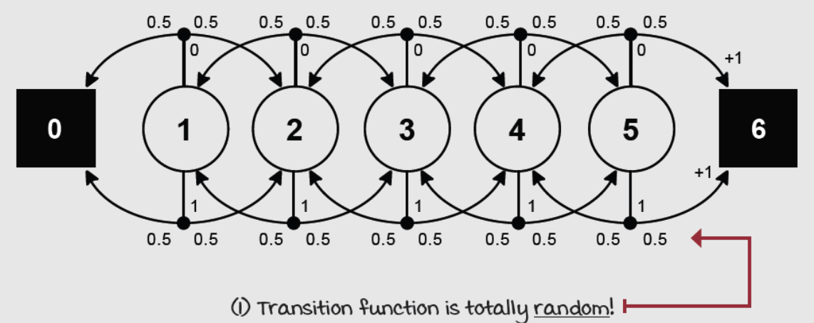
Random Walk Environment
A single-row grid-world environment
five non-terminal states
the agent has no control of where it goes!
probability of going left is equal to the probability of going right
the goal is to estimate the expected total discounted reward the agent can obtain given these circumstances
Useful when focusing on the eveluation problem
the dynamics of the environment make policy being evaluated irrelevant

Slide 6

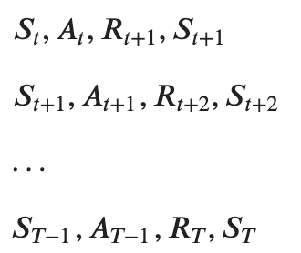
Monte Carlo prediction (1)
The goal is to estimate the state-value function 𝑣_{𝜋}(𝑠) of a policy 𝜋:
We can run several episodes with this policy, collect hundreds of trajectories and then calculate averages for every state
agent interacts with the environment using the policy until a terminal state
the collection of (𝑆_{𝑡}, 𝐴_{𝑡}, 𝑅_{𝑡+1}, 𝑆_{𝑡+1}) is called an experience tuple
a sequence of experiences is called a trajectory

Slide 7

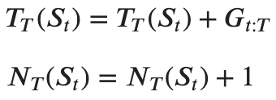
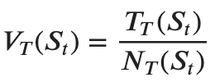
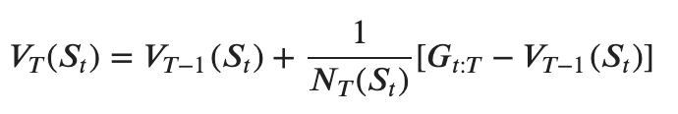

Monte Carlo prediction (2)
Once we have a trajectory, we can calculate the returns 𝐺_{𝑡}
Then, add up the per-state returns and increment a count
Finally, we can estimate the expectation using the empirical mean (also incrementally)
As the counts approach infinity, the estimate will approach the true value

Slide 8

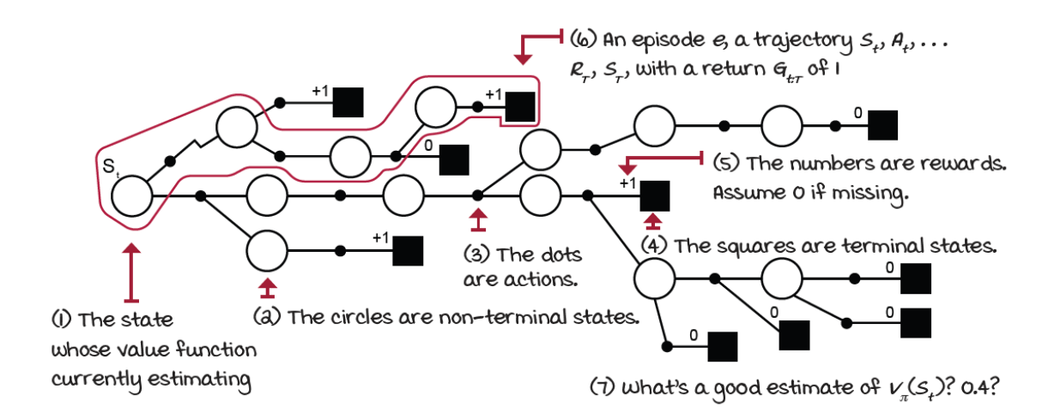
Monte Carlo prediction (3)
We can replace the mean for a learning rate
𝐺_{𝑡:𝑇} is the MC target
𝐺_{𝑡:𝑇} − 𝑉_{𝑇−1}(𝑆_{𝑡}) is the MC error
Notice that V is calculated only at the end of an episode
because the returns depends on it

Slide 9
Monte Carlo prediction (4)
The learning value can be time dependant
this hyperparameter is essential
a constant alpha helps with learning in non-stationary environments
we can decay alpha in order to show convergence
A single trajectory may contain multiple visits to the same state
should we calculate the returns following each of those visits independently?
should we only use the first visit to each state?
Both are valid approaches, and they have similar theoretical properties
the more standard version is First-Visit Monte Carlo (FVMC)
convergence properties are easy to justify
Every-visit Monte Carlo (EVMC)
proven to converge also
See “monte-carlo-prediction.ipynb”

Slide 10
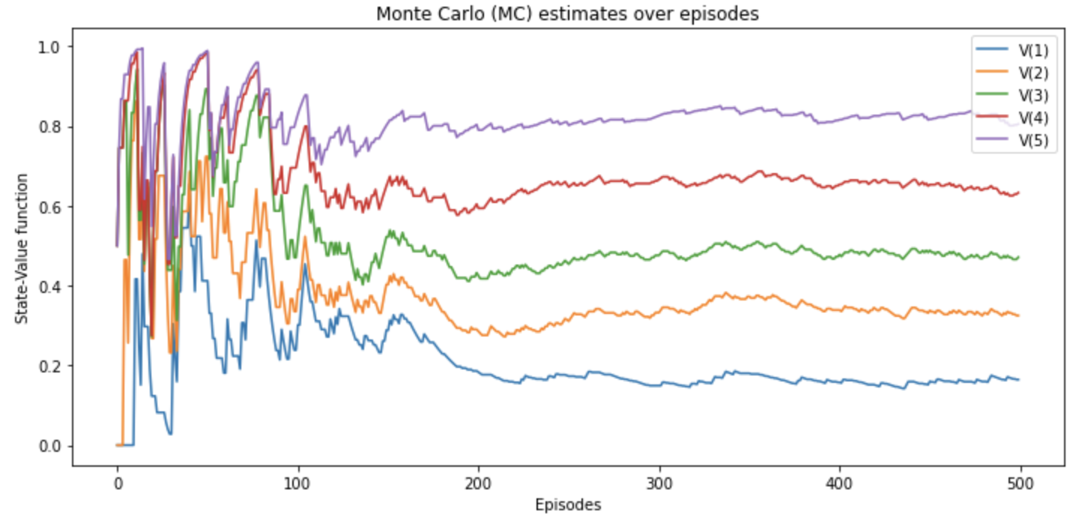
Monte-Carlo prediction (5)
MC convergence to the true values
running estimates are very noisy
jump back and forth around the true values

Slide 11
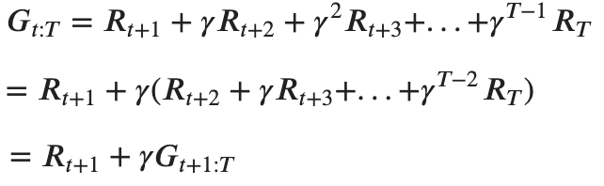
Temporal-Difference Learning (1)
In MC the agent has to wait until the end of an episode before it can update the estimate
solid convergence properties: it updates the estimate using the actual return, which is an unbiased estimate
however, the actual returns are also high-variance estimate as they accumulate many random events in the same trajectory
Instead, we can wait for a single step
we get a single-step reward R_{t+1}
we observe the next state S_{t+1}
use the current V to estimate the return at the next step G_{t+1:T}= V(S_{t+1})

Slide 12
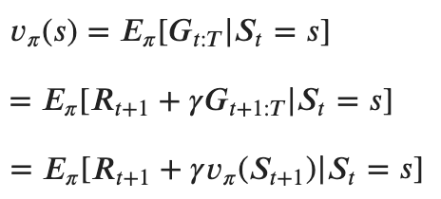
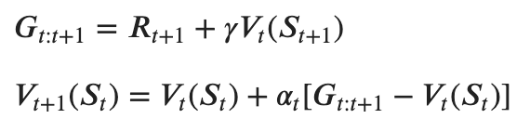
Temporal-Difference Learning (2)
Using the previous recursive formula and we can rewrite the state-value function equation:
This means we could estimate the value function on every time step
𝐺_{𝑡:t+1} is the TD target
𝐺_{𝑡:t+1} − 𝑉_{t}(𝑆_{𝑡}) is the TD error

Slide 13
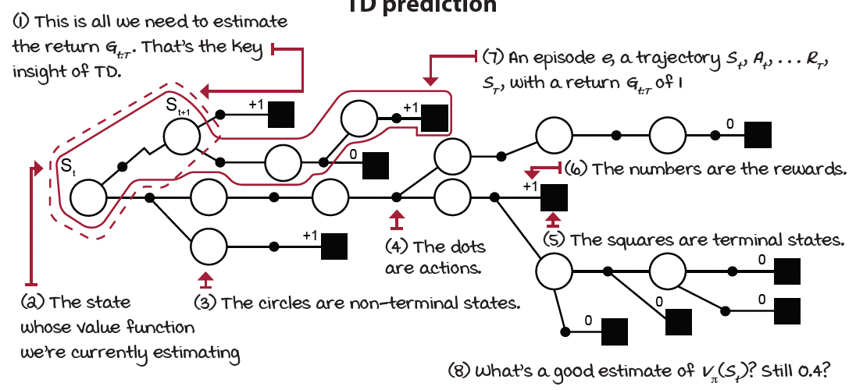
Temporal-Difference Learning (3)
TD estimates the value function using an estimate of the value function
reward signal progressively injects reality into the estimates.
bootstrapping

Slide 14
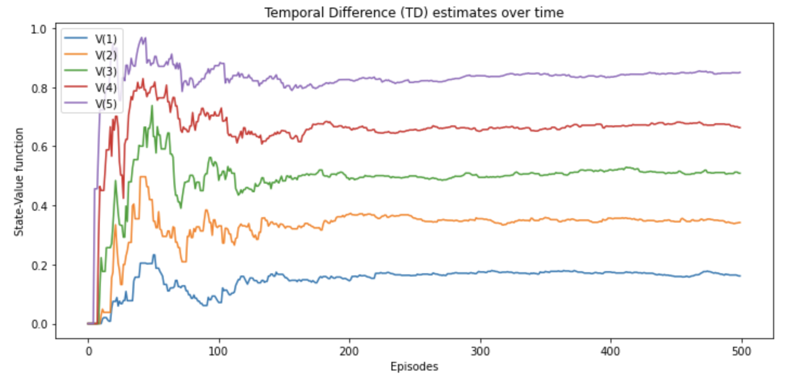
Temporal-Difference Learning (4)
It is a combination of MC and DP ideas
like Monte Carlo, it learn directly from raw experience (without a model)
like dynamic programming, it update estimates based on other learned estimates (without waiting for a final outcome)
See ” temporal-difference-estimation.ipynb

Slide 15
Batch updating (1)
Suppose there is available only a finite amount of experience
a common approach is to present the experience repeatedly until the method converges upon an answer
Suppose we observe the following episodes:
(A, 0, B, 0); (B, 1); (B, 1); (B, 1); (B, 1); (B, 1); (B, 1); (B, 0)
first episode started in A, transitioned to B and terminates with a reward of 0
other episodes were shorter, starting from B and terminating immediately
What are the optimal estimates V(A) and V(B)?
probably we agree that the optimal value for V(B) is 3/4
six out of the eight times in state B the process terminated immediately with a return of 1; the other two times terminated with a return of 0
but what is the optimal value for V(A)?

Slide 16
Batch updating (2)
Two reasonable answers
notice that all the times the process was in state A, it travers to B and because we have decided that V(B) is 3/4 , therefore A have value 3/4 as well
this is the answer that TD gives
simply observe that we have seen A once and the return that followed it was 0, we therefore estimate V(A) as 0
this is the answer that MC gives
it is also the answer that gives minimum squared error on the training data
still we expect the first answer to be better: we expect that the first answer will produce lower error on future data
This illustrates a general difference between TD and MC methods
MC always find the estimates that minimize mean-squared error on the training set
TD always finds the estimates for a model of the Markov process

Slide 17
Batch updating (3)
The TD model is formed from the observed episodes
estimated transition probability from i to j is the fraction of observed transitions from i that went to j
the associated expected reward is the average of the rewards observed on those transitions
Given the model, we can compute the estimate of the value function that would be exactly correct if the model were exactly correct
This helps to explain intuitively why TD method converges more quickly than MC method

Slide 18
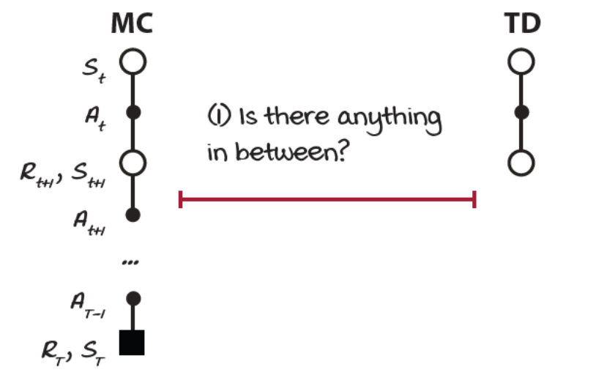
n-steps TD (1)
There something in between?
MC samples the environment all the way through the end of the episode before it estimates the value function
TD interacts with the environment only once, and it estimates the value function
How about bootstrapping after two steps? Three? Four?
there’s a spectrum of algorithms lying in between MC and TD
we can tune how much bootstrapping, letting us balance bias and variance

Slide 19

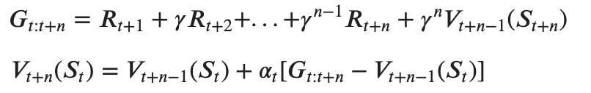
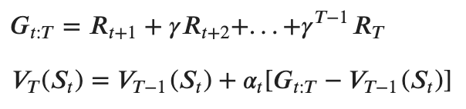
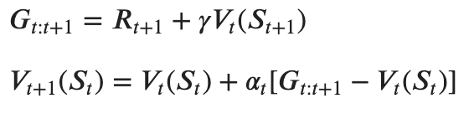
n-steps TD (2)
Two extremes
MC is an infinite-step method: goes all the way until the end of the episode
TD is a one-step method: interacts with the environment for a single step
We can generalize into an n-step method
instead of doing a single step or the full episode, it uses n-steps
and then it makes the estimation
𝐺_{𝑡:t+n} is the n-step TD target
𝐺_{𝑡: t+n} − 𝑉_{𝑇+n−1}(𝑆_{𝑡}) is the n-step TD error
See ”n-step-temporal-difference-estimation.ipynb”
MC
TD

Slide 20
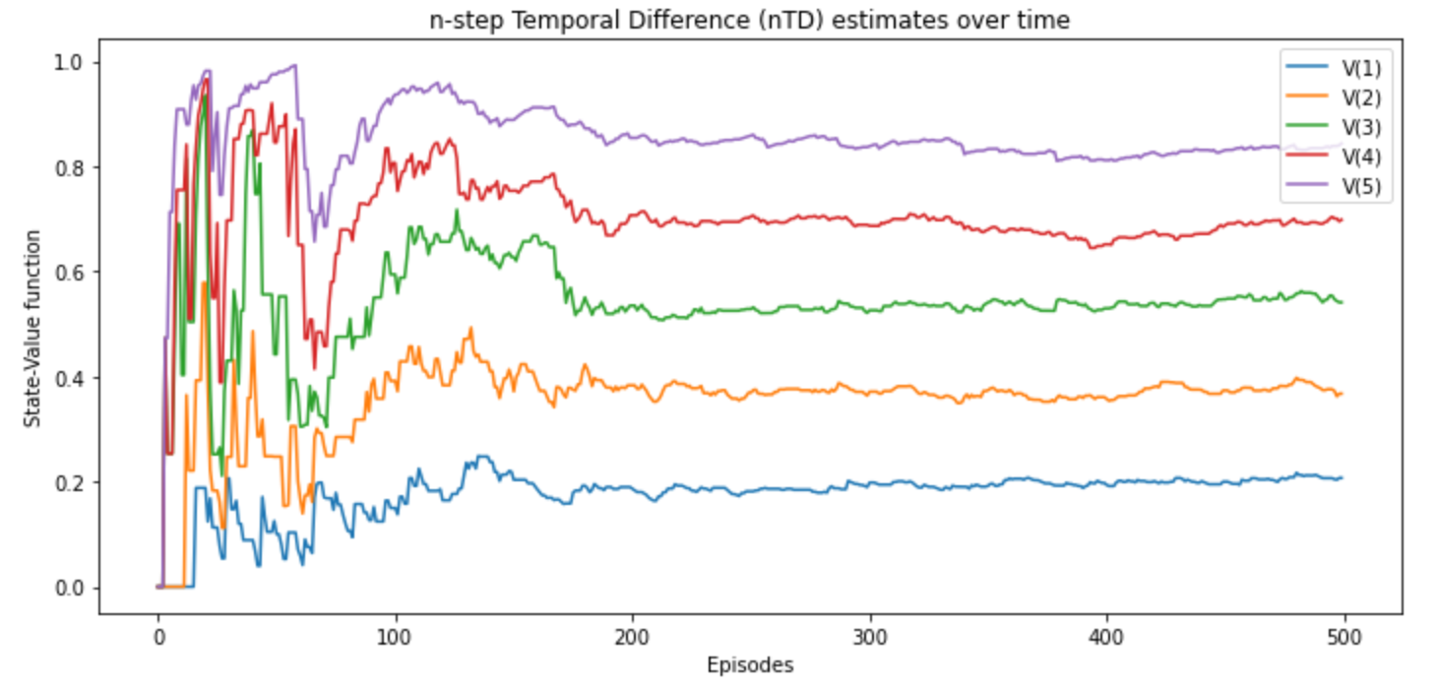
n-steps TD (3)

Slide 21
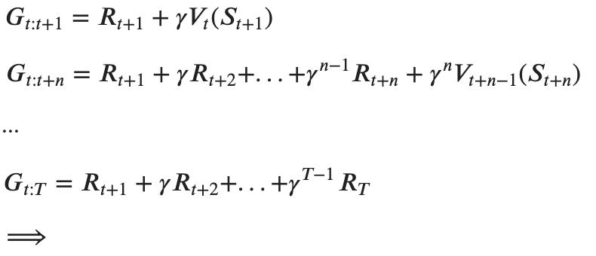
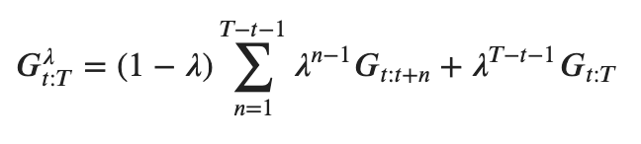
TD(𝜆) (1)
A question emerges: what is a good n?
How using a weighted combination of all n-step targets
the agent could go out and calculate the n-step targets corresponding to the one-, two-, three-, ..., infinite-step target
then mix all of these targets with an exponentially decaying factor 𝜆
We calculate the one-step return and weight it with the 1−𝜆 factor, and the 2-step return and weight it with (1−𝜆)𝜆 factor, and the 3-step return and weight it with (1−𝜆)𝜆² factor, and so on for all n-steps return until the agent reaches a terminal state

Slide 22

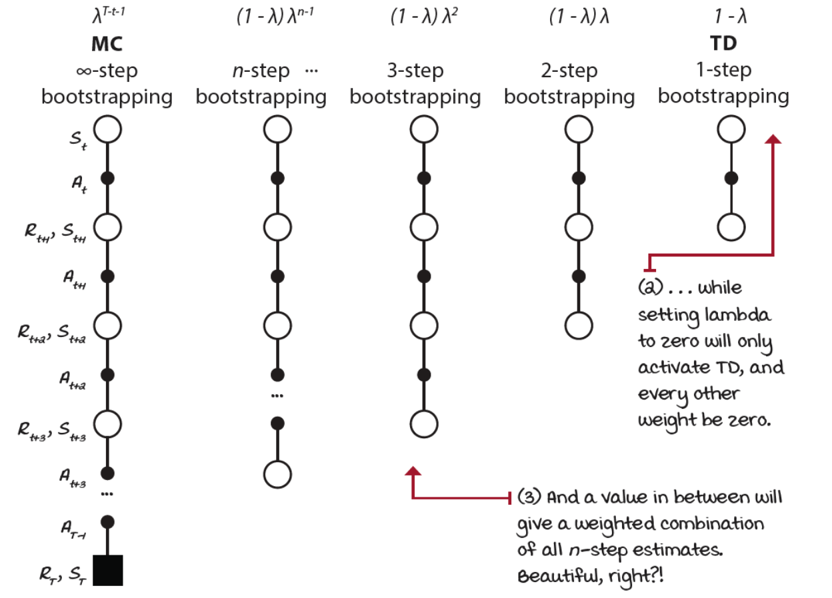
TD(𝜆) (2)
In the end, we can evaluate the estimate of the value function using this expression of the return:

Slide 23



Backward-view TD( 𝜆 ) (1)
With TD( 𝜆 ) we must wait until the end of an episode (like MC)
We can split the updates into partial updates
we track states that are eligible for an update on every step by how much
Mechanism called eligibility traces
at the begging of every new episode, we set the eligibility vector to zero E₀=0
we interact with the environment one cycle S_{t}, A_{t}, R_{t+1}, S_{t+1}
when we encounter a state, we add a one to its trace E_{t}(S_{t}) = E_{t}(S_{t}) + 1
in order to make it eligible for an update
we calculate the TD error
we update the value function for all states using the eligibility trace vector
only eligible will get updated
after the update, the eligibility trace vector is decayed
so that future reinforcing events have less impact on earlier states

Slide 24
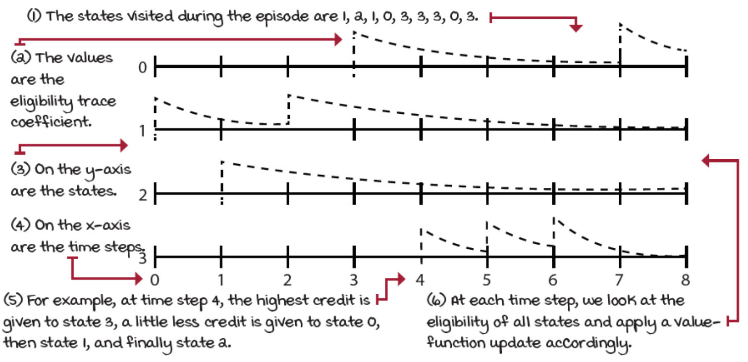
Backward-view TD( 𝜆 ) (2)
In this way, most recent states get more significant credit for a reward encountered in a recent transition than those states visited earlier in the episode

Slide 25
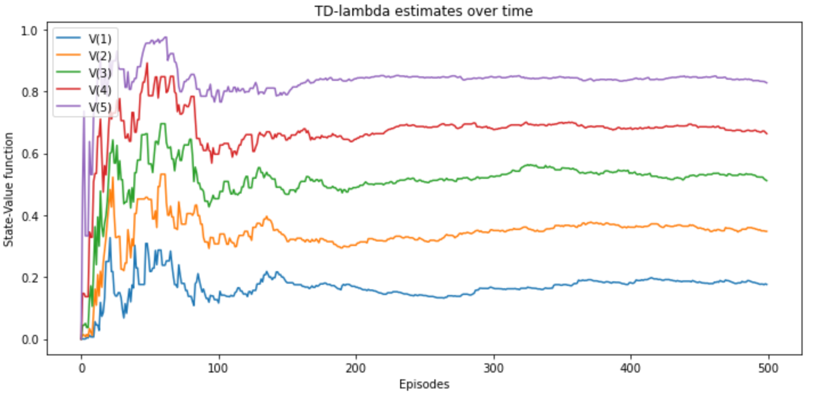
Backward-view TD( 𝜆 ) (3)
Notice that
TD(𝜆) when 𝜆=0 is equivalent to the TD method: TD(0)
TD(𝜆) when 𝜆=1 is equivalent to MC: TD(1)
See ”td-lambda.ipynb”

Slide 26
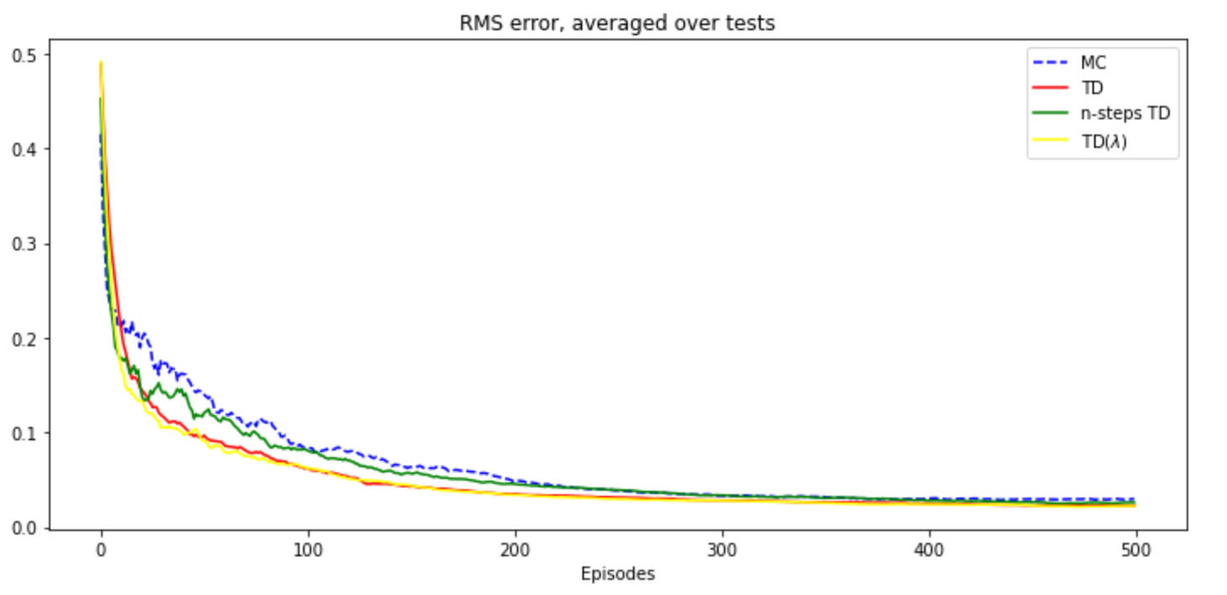
Comparison
Run an experiment over 100 runs
calculate the learning curves
measure the root mean-squared (RMS) error between the learned and the true values
See ”comparison.ipynb”

Slide 27
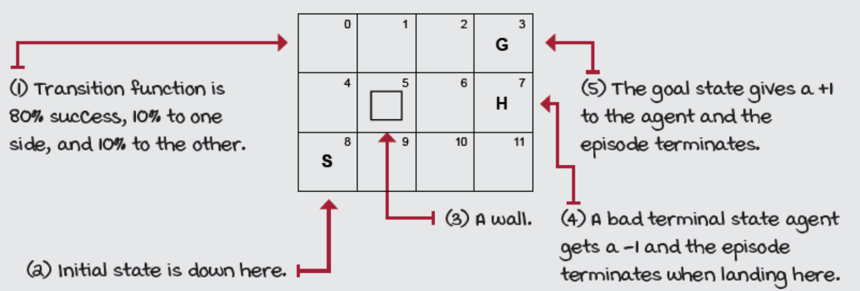
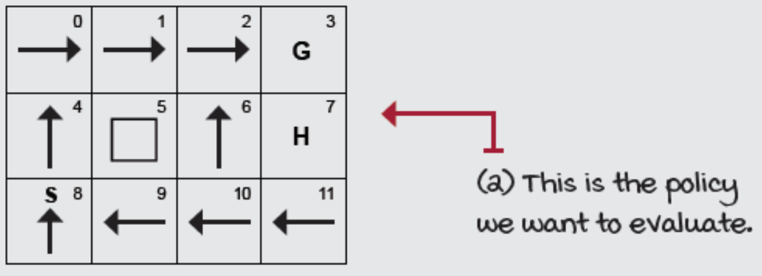
Exercise
1 - Create the following Gridworld
2 - Write the optimal policy for this environment
3 - Evaluate this policy using TD(𝜆) and plot the state-value function estimates over episodes
See “notebook – exercise-solution.ipynb”

